Slide 1

College-wide
Strategic Enrollment Plan (SEM)
UPDATED: 10/27/21

Slide 2
College-wide Strategic Enrollment Management Plan Overview
Overview: 3 -year plan; 5% enrollment increase
What: A collaborative approach to identify, recruit, enroll, retain, close equity gaps, and graduate the student body.
Why:
  Increase Student Success
  Improve Campus Climate
  Obtain Financial Stability
  Expand & Deepen Community Engagement

Slide 3
Advancing Justice for the Clark College Community
Racial Equity
Clark College leads with racial equity as a holistic approach to identify barriers and best practices relating to the retention, enrollment, and completion of historically underrepresented racial and ethnic groups. Using data to guide us, we proactively seek out best practices and eliminate barriers to ensure equitable outcomes for students and employees. We accomplish this through abolishing practices that do not effectively serve students or employees, dismantling White Supremacy Culture, and by adopting principles of anti-racism, disability justice, and universal design.

Slide 4




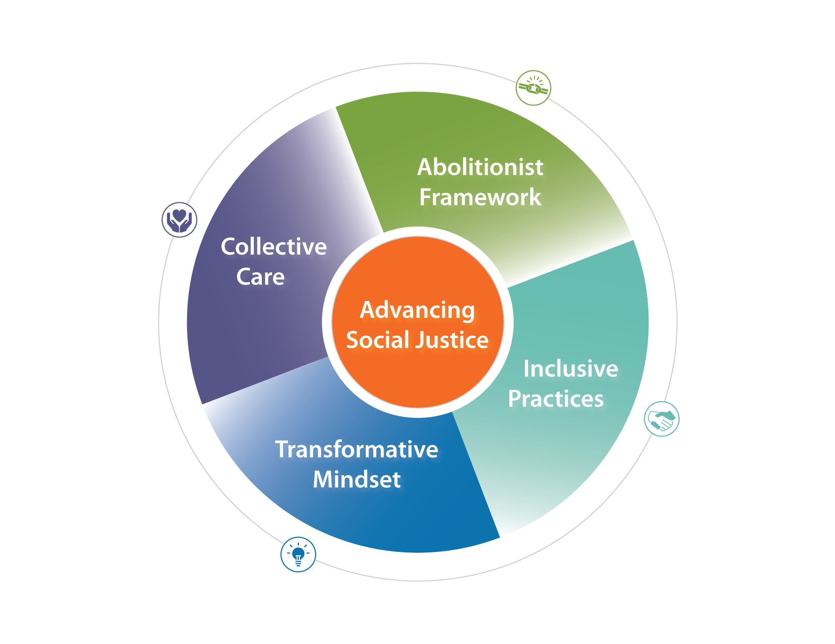
Advancing Justice for the Clark College Community
Racial Equity
Abolitionist Framework
Collective Care
Inclusive Practices
Transformative Mindset

Slide 5
College-wide SEM Stakeholders List
Department | Staff/Committees
ODEI | Michele/Cindi/Rashida/Melissa
Retention | Michele/Cath B./Heather A./Julie
SAC | SAC review at Retreat
Business Office | Michele/Sabra
Instruction | Michele/Genevieve
ASCC | Student Government Review
SA | Review at SA All-staff meeting
IC | Review at Instructional Council
IPT | Committee/Genevieve
EC Review | Executive Cabinet Meeting
SAC/IC | Town Hall Meeting & IC/SAC Meeting
BOT | Board of Trustees Work Session
IT | Michele/Genevieve/Val
SEC | Social Equity Committee
COM/MAR | Communications & Marketing Consultants

Slide 6
College-wide Strategic Enrollment Management Plan Goals
Achieve All Goals By 2024
Goal I: Increase prospect pool by 20%, increase conversion from prospect to applicant by 10%, increase applicant to enroll students by 5%, and experience flat enrollment.
Goal II: Increase improve fall-to-fall retention of all students by 10%.
Goal III: Reduce the equity gap by 50% for non dominant historically underrepresented students in retention, progression, and completion.
Goal IV: Increase student success outcomes by 5%.
Goal V: Increase enrollment at CTC & CCW by 5% through Intentional Pathways and Holistic Support Services.

Slide 7
Goal I: By 2024, increase prospect pool by 20%, increase conversion from prospect to applicant by 10%, increase applicant to enroll students by 5%, and experience flat enrollment.
Strategies
Review, revise, and implement comprehensive prospective student recruitment and marketing systems.
Create systems and models to support enrollment management.
Create enrollment funnel to determine where students fall out of the funnel and implement intentional supports to pull students through.
Increase outreach and recruitment efforts to Transitional Studies students.
Develop and Implement placement prep Math boot camp that can be offered with a condensed COLL101 in Summer.
Streamline Running Start Enrollment Process.
Increase number of students who apply for Financial Aid.

Slide 8
Goal II: By 2024, increase fall-to-fall retention of all students by 10%.
Strategies
Through an equity-focused lens, reengage and revitalize college-wide guided pathways work by enhancing the student experience.
Engage data coaches, use data-informed strategies, and data dashboards to guide programming and assessment.
Increase the number of fully online degree pathways available to students and focus on high quality content and engagement
Implement “all-user” adoption of an Early Alert System
Create, within the framework of caseload advising, checkpoints for all students.

Slide 9
Goal II: By 2024, increase fall-to-fall retention of all students by 10%.
Strategies (Cont.)
Implement optimal annual course scheduling designed to allow student to efficiently complete degrees and certificates or transfer.
Implement evidence-based placement practices.
Implement College 101 or outcomes in every pathway.
Expand use of Open Educational Resource (OER).
Successful completion of English and Math in first year with supports.
Reactivate identity-based student clubs.

Slide 10
Goal II: By 2024, increase fall-to-fall retention of all students by 10%.
Strategies (Cont.)
Implement Case Load Appreciative Advising.
Implement Auto Enrollment for existing cohort programs.
Identify pathways where COLL101 or embedded outcomes are not present.

Slide 11
Goal III: By 2024, reduce the equity gap by 50% for non-dominant historically underrepresented students in retention, progression, and completion.
Strategies
Implement culturally inclusive programming, engagement, services and activities (e.g., culturally responsive orientation; academic appreciative advising; holistic supports for systemically non dominant population, through equity competent Career exploration and/or College Success Courses).
Develop co-requisite courses and other student supports to reduce equity gaps in gateway course success.
Embed program-relevant Power, Privilege, and Inequity course work into all degree programs.
Increase the number of systemically non-dominant students entering and completing high-demand, high wage programs.

Slide 12
Goal III: By 2024, reduce the equity gap by 50% for non-dominant historically underrepresented students in retention, progression, and completion.
Strategies (Cont.)
Enhance academic student supports to reduce equity gaps in course success.
Accelerate rates of English completion within the first year.
Accelerate rates of math completion within the first year.
Leverage the efforts of TLC, ODEI, and SBCTC to provide equity focused professional development training for faculty & staff.
Create MESA mentorship program to increase historically underrepresented student of color enrollment, retention, and completion in STEM-related programs.
Continue to infuse culturally responsive curriculum throughout Clark programs.

Slide 13
Goal IV: By 2024, increase student success outcomes by 5%.
Strategies
Intentional Marketing and Outreach Plan
Expand partnerships with industry, community organizations, and K-12.
Assess the effectiveness of existing K-12 CTE articulations.
Assess & resolve barriers in courses, processes, & placement, etc.
Utilize the program viability process to ensure programs are tied to industry and community needs.
Assessment of student support, ensure intentional student milestones (i.e.. Connection to Advisors and Faculty).
Provide opportunities for career connection early in pathway.
Develop part-time pathways for degree programs.

Slide 14
Goal V: By 2024, increase enrollment at CTC & CCW by 5% through Intentional Pathways and Holistic Support Services.
Strategies
Rebrand Columbia Tech Center.
Provide Holistic Support Services at CTC and CCW.
Create CCW as Home to Allied Health Pathways.
Maximize course scheduling for Running Start participation at CTC/CCW, and plan for Boschma Farms campus.
Generate student and community interest in Boschma Farms campus.
Identify High-Demand BAS Programs to be located at CTC/CCW.
Develop and expand partnerships with industry and labor partners around CCW (e.g., Legacy, PeaceHealth, SIEU, etc.). Includes pathways for incumbent workers; internships/externships; placement upon completion.

Slide 15
Goal V: By 2024, increase enrollment at CTC & CCW by 5% through Intentional Pathways and Holistic Support Services.
Strategies (Cont.)
Develop and expand partnerships with industry and labor partners around CCW (e.g., Legacy, PeaceHealth, SIEU, etc.). Includes pathways for incumbent workers; internships/externships; placement upon completion.
Create course schedules that maximize simplicity for Running Start participation at CTC/CCW, including district-specific class offerings and alternate day/time/location to meet part-time needs.

Slide 16
Next Steps
Committee to finalize metrics for goals (budget, FTE projections, etc.)
Committee to prioritize strategies/ Framework for 2021-2022 academic year
Development of a College-wide Strategic Enrollment Management Data dashboard by Sep 15
Establish tracking milestones ~ goals
Identify leading vs. lagging indicators

Slide 17
College-wide Strategic Enrollment Management Committee Members
Michele Cruse, Interim Vice President of Student Affairs
Genevieve Howard, Interim Vice President of Instruction
Rashida Willard, Vice President of Diversity, Equity, and Inclusion
Mirranda Saari, Associate Dean of Enrollment Services and Registrar
Vanessa Watkins, Director of Entry Services
Cath Busha, Dean of Student Engagement
John Maduta, Director of Advising
Miles Jackson, Interim Associate Vice President of the Office of Instruction
Armetta Burney, Interim Dean of Workforce, Professional & Technical Education
Brenda Walstead, Dean of Business & Health Sciences
Chippi Bello, Associate Dean of Financial Aid
Julie Robertson, Director of Grant Development
Kevin Damore, Director of Marketing
Cindi Olson, Executive Assistant to the Interim Vice President of Student Affairs

Slide 18

Questions?

